Slide 1
Data Visualisation using power BI
Batch SVT/DAINT/2025/06/BO9
SoulVibe Intern as DataAnalyst

Slide 2
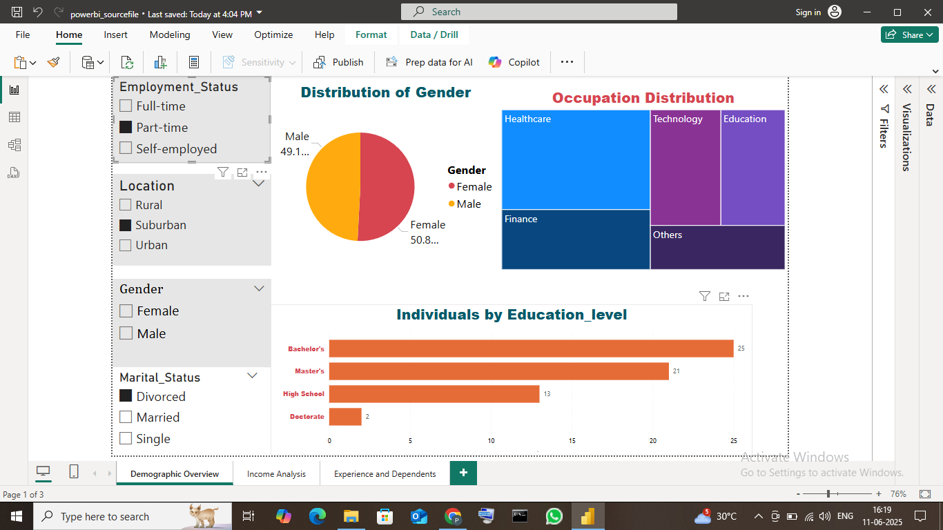
Demographic Overview

Slide 3
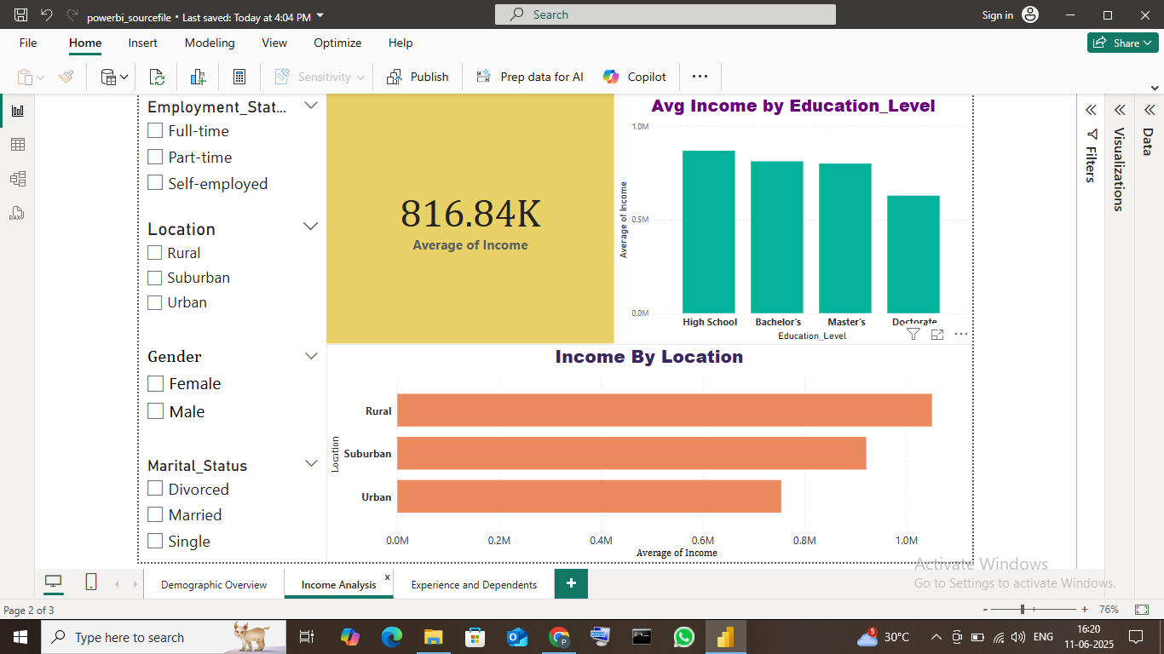
Income Analysis

Slide 4
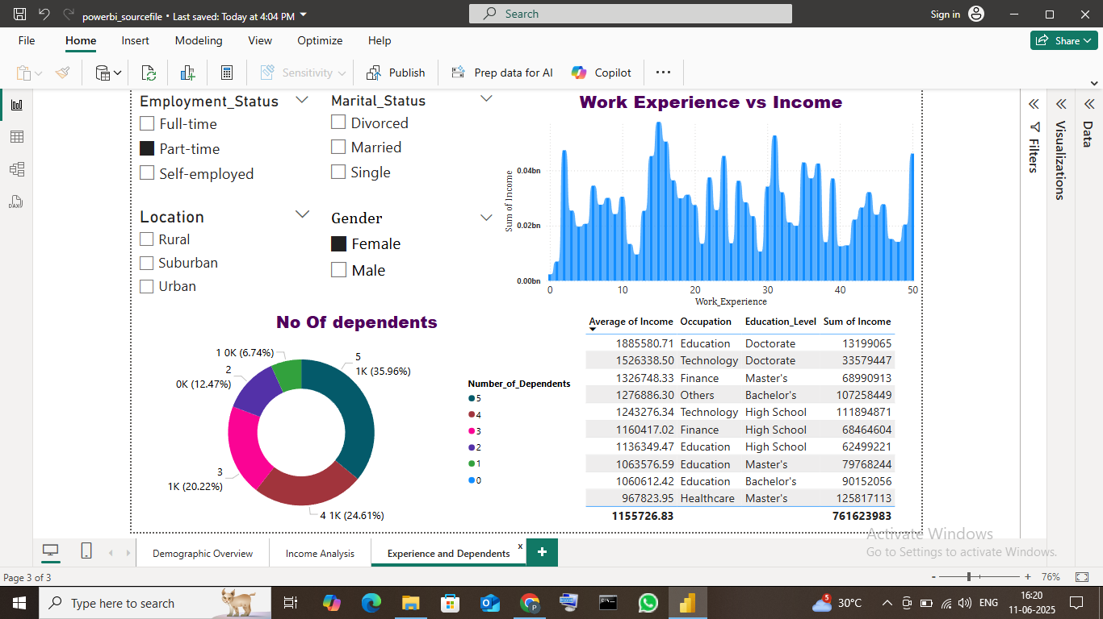
Experiences & Dependents

Slide 5
Conclusion:
Enabled Dynamic filtering.
Presented multi perspective insights on dataset.
As a result , a analysed professional dashboard ready for business use.
This projects helps me to work with practical insights of skills for data analysis.
Helps me to do Real world applications using interactive tools of powerBI.

